Slide 1
Dr. Zakir HUSAIN URDU junior
college of education,
Mominpura nagpur.
2019-2020
Subject:- new concepts in education ( s3)
Topic:- ShIvAji JAyaNti
GuidAnce by:- shaHenaz quazi Mam

Slide 2
Group member:-
1) Aafreen Jahan
2) Sayema Rafi
3) Masroor Fatema
4) Rabiya Bano
5) Saima Abrar
6) Tasbirunnisa
7) Shumaila Parveen
8) Nida Khanam
9) Aliya Parveen
10) Sabbo Bano
11) Nida Aafreen
12) Tanzila Jabir

Slide 3
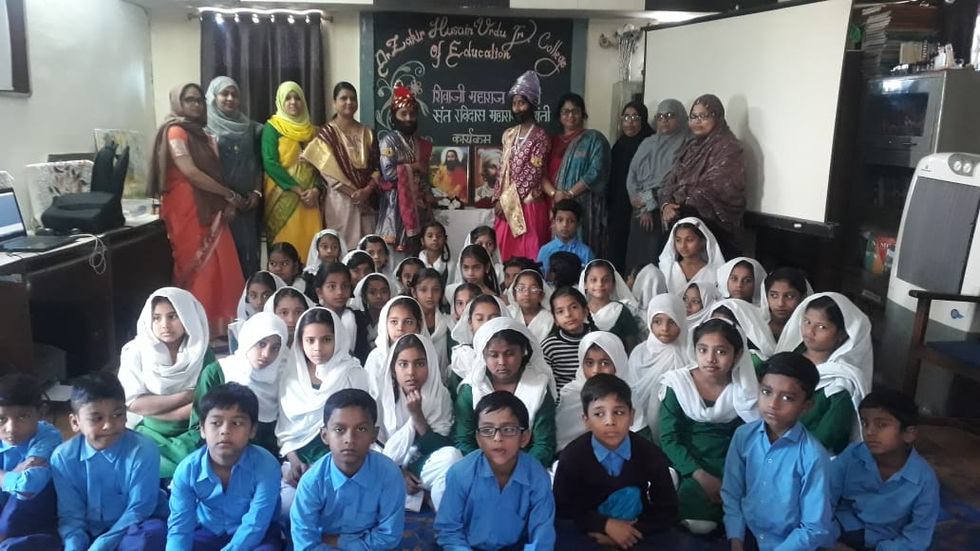
شیواجئ جینتی

Slide 4
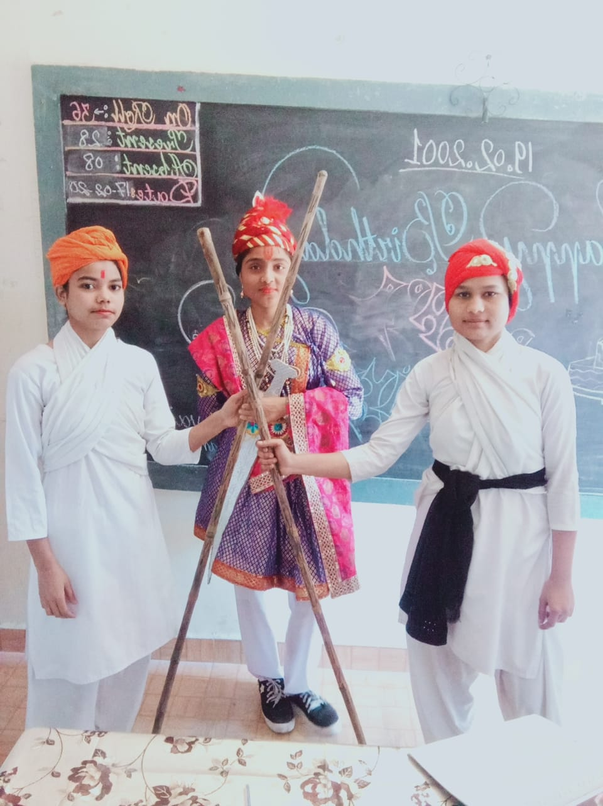
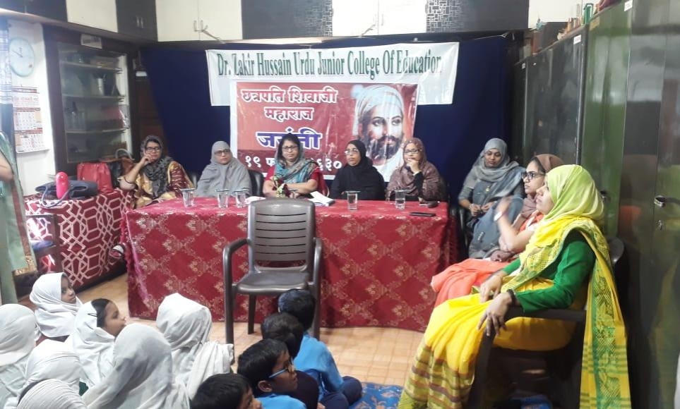

Slide 5
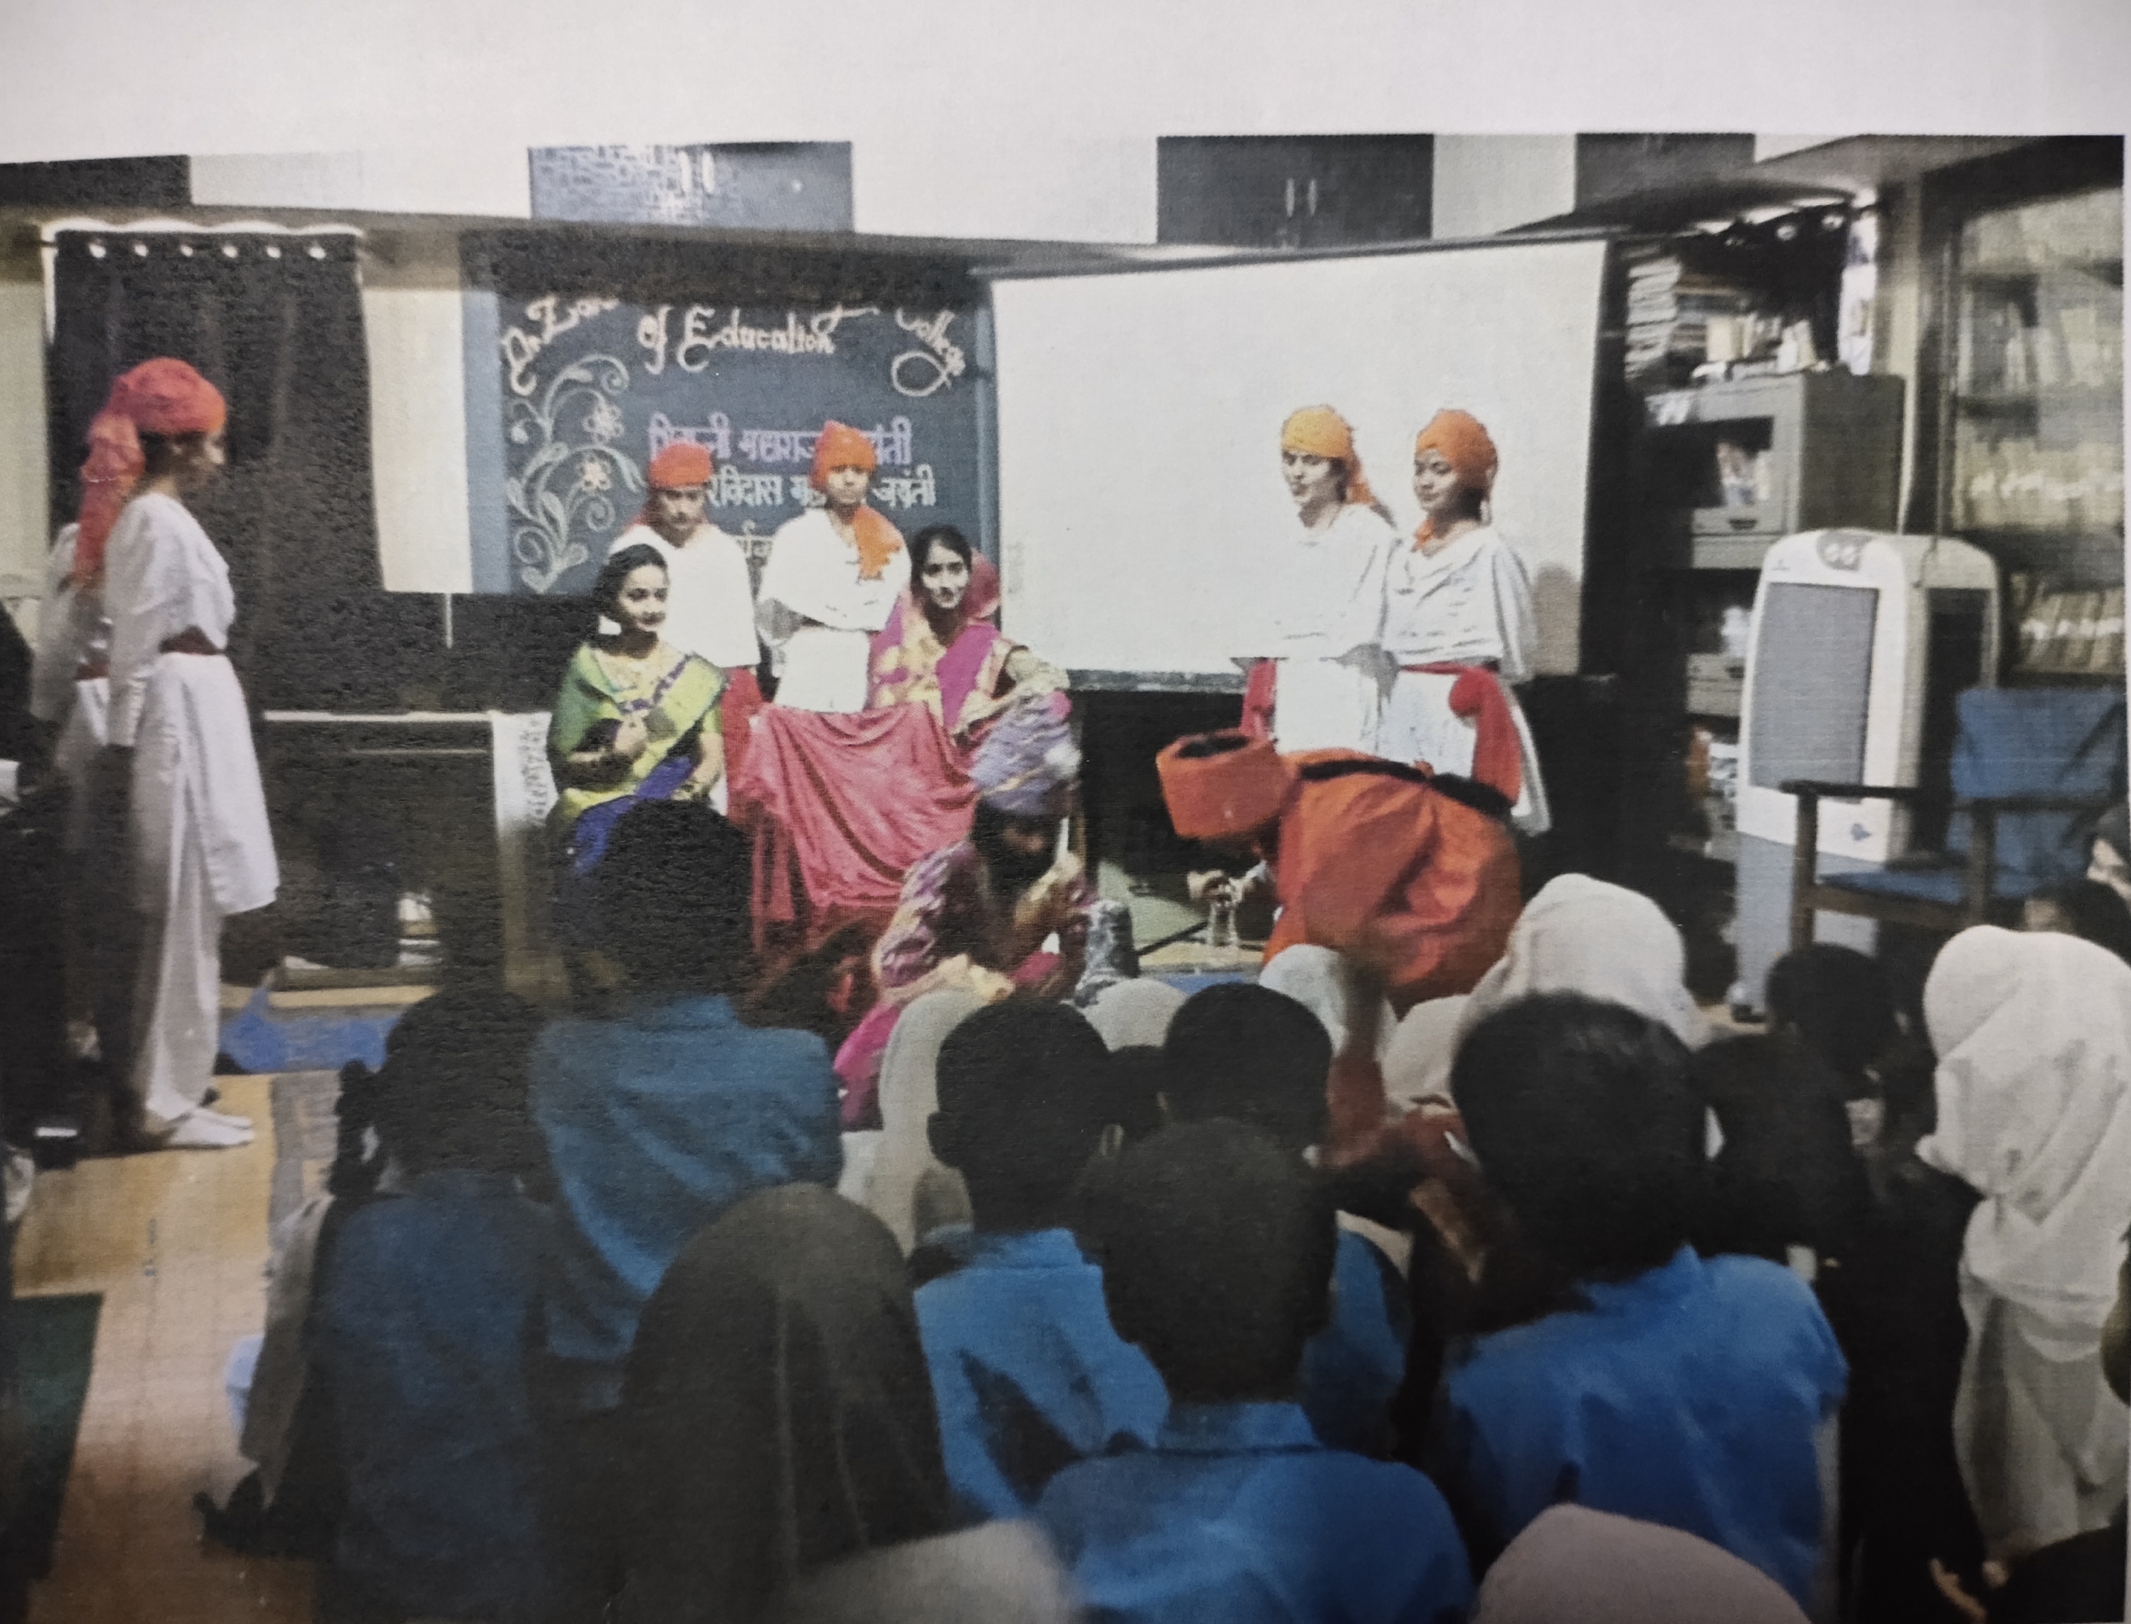
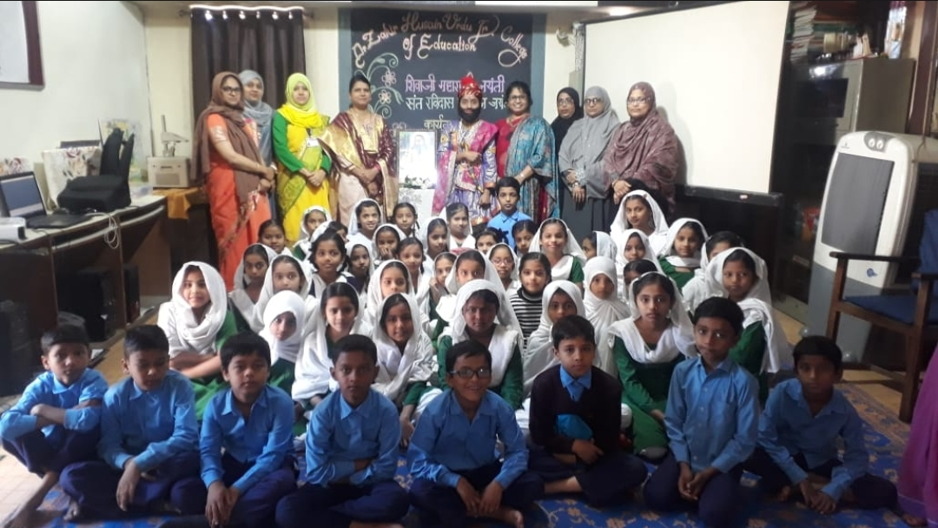

Slide 6
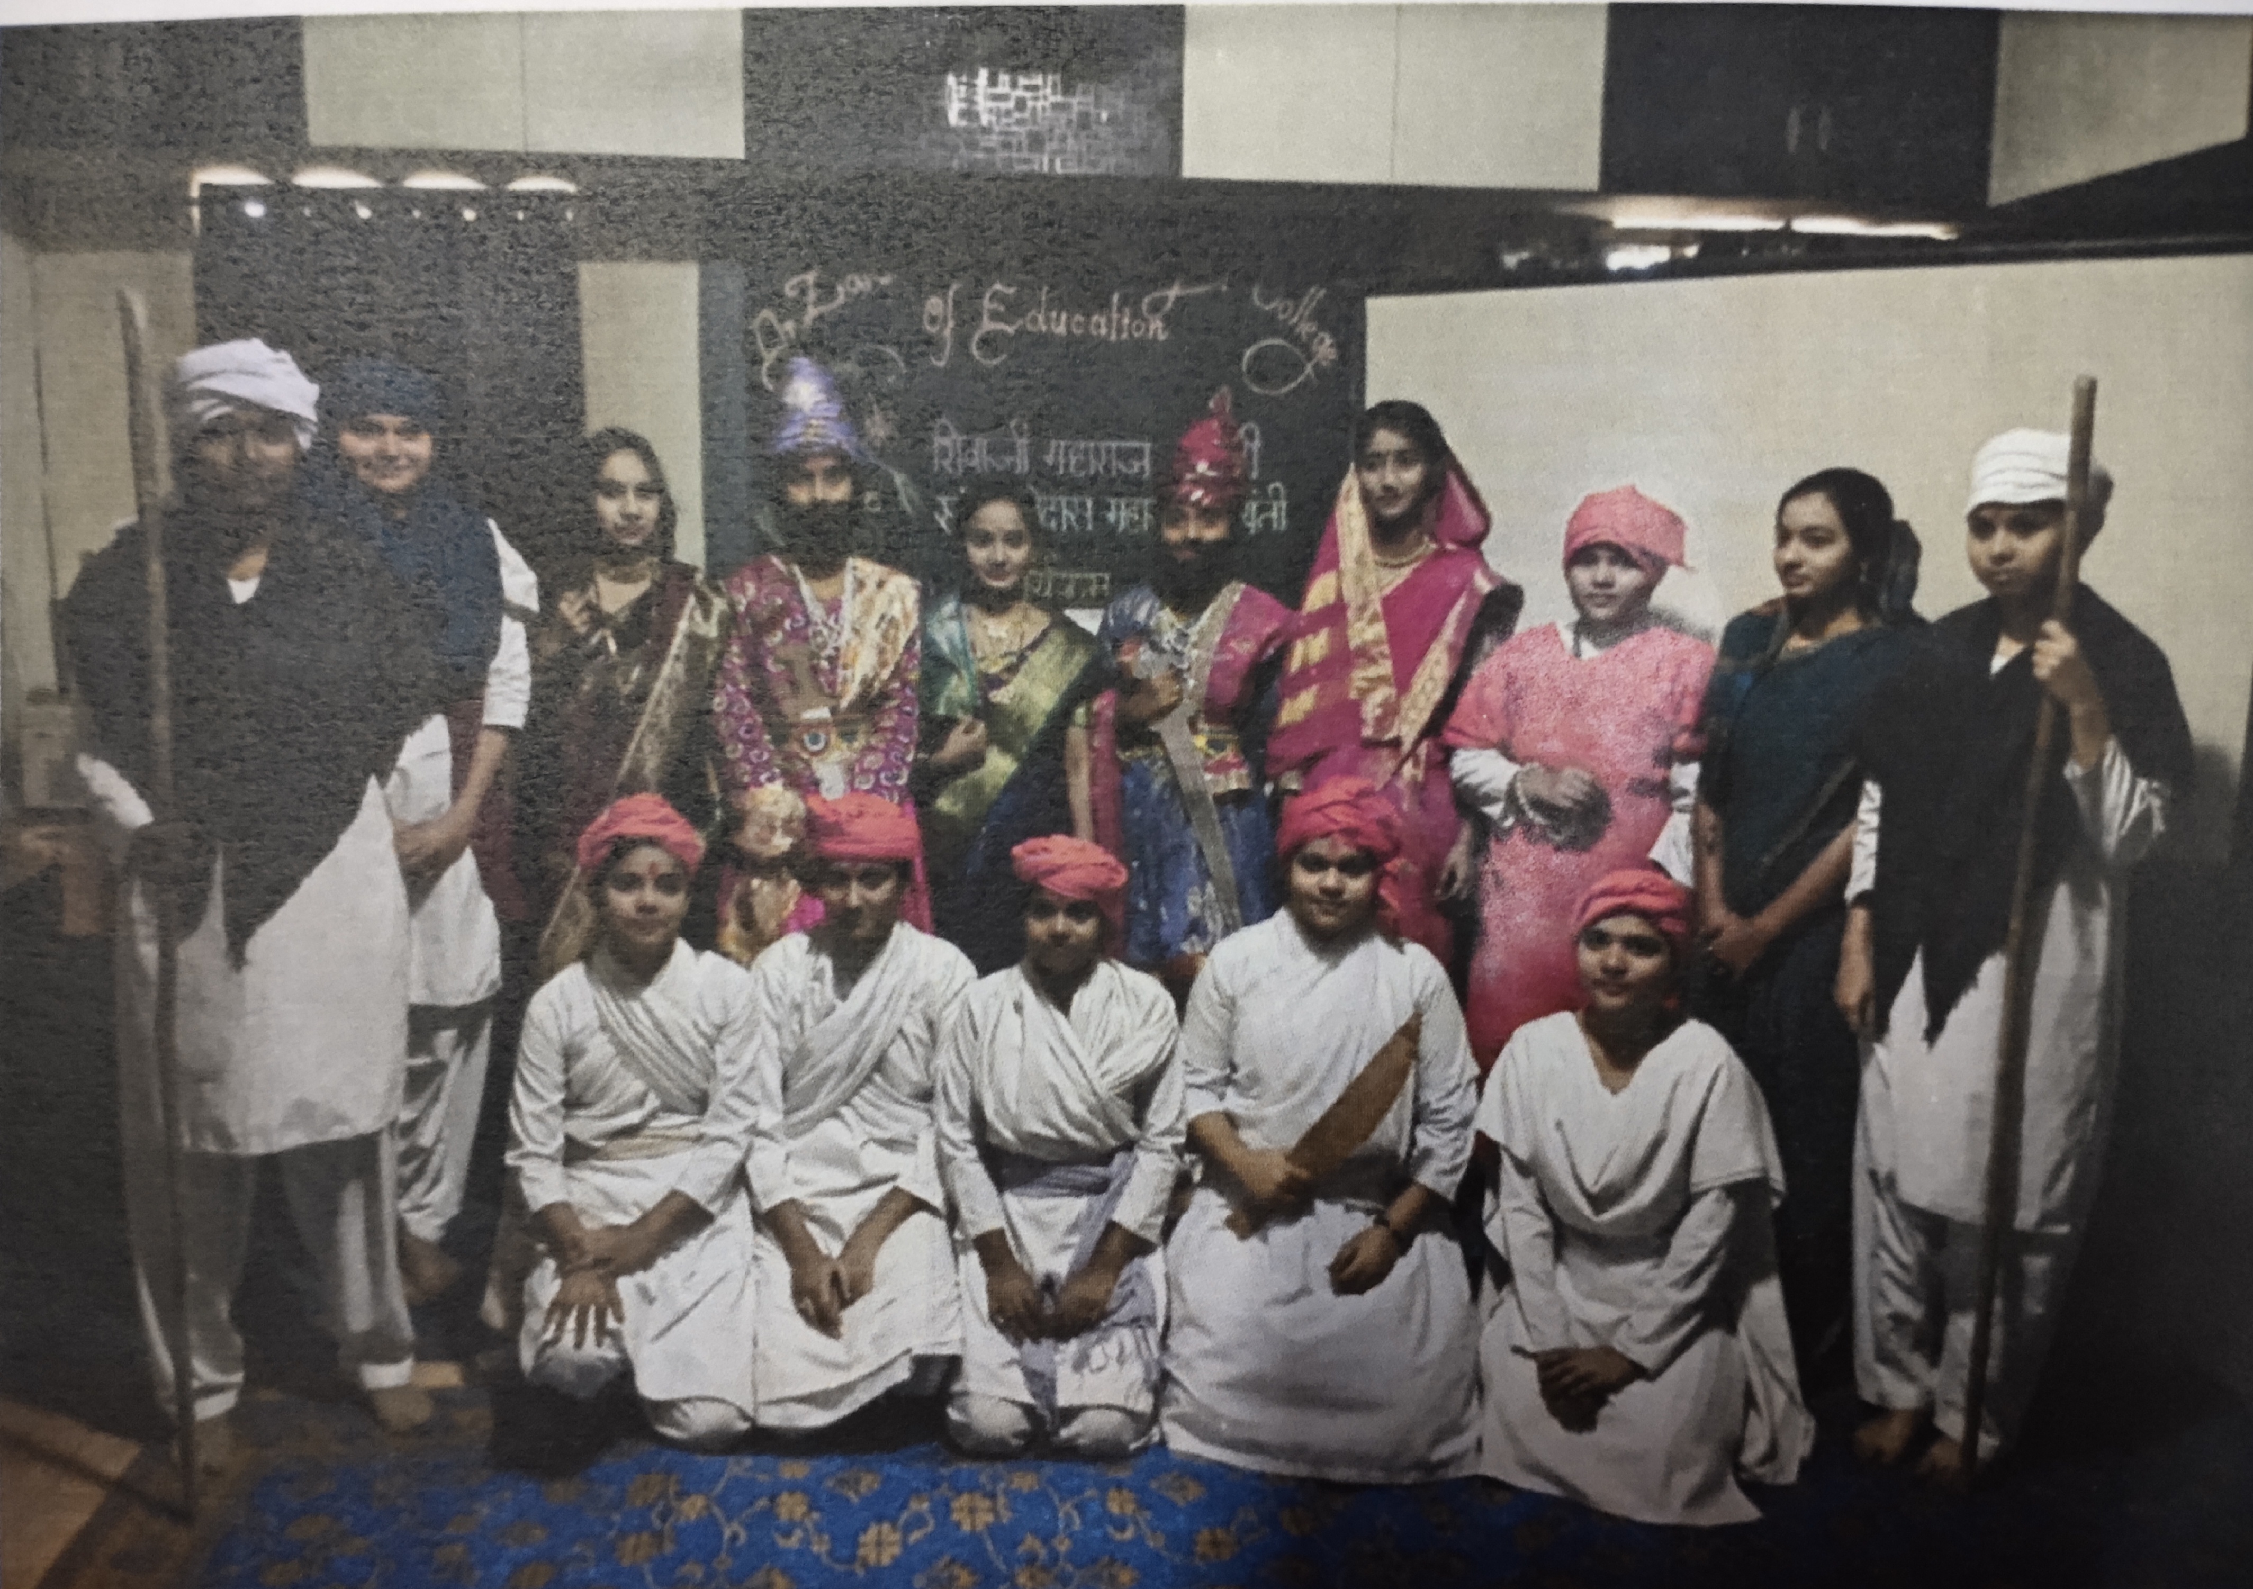
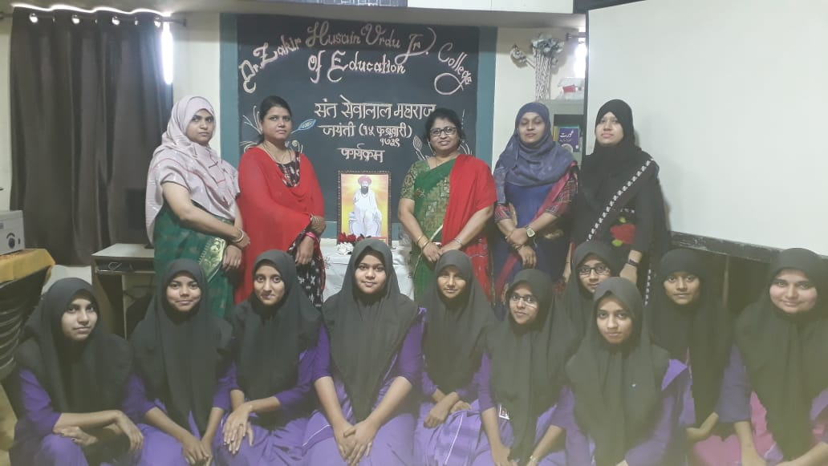

Slide 7
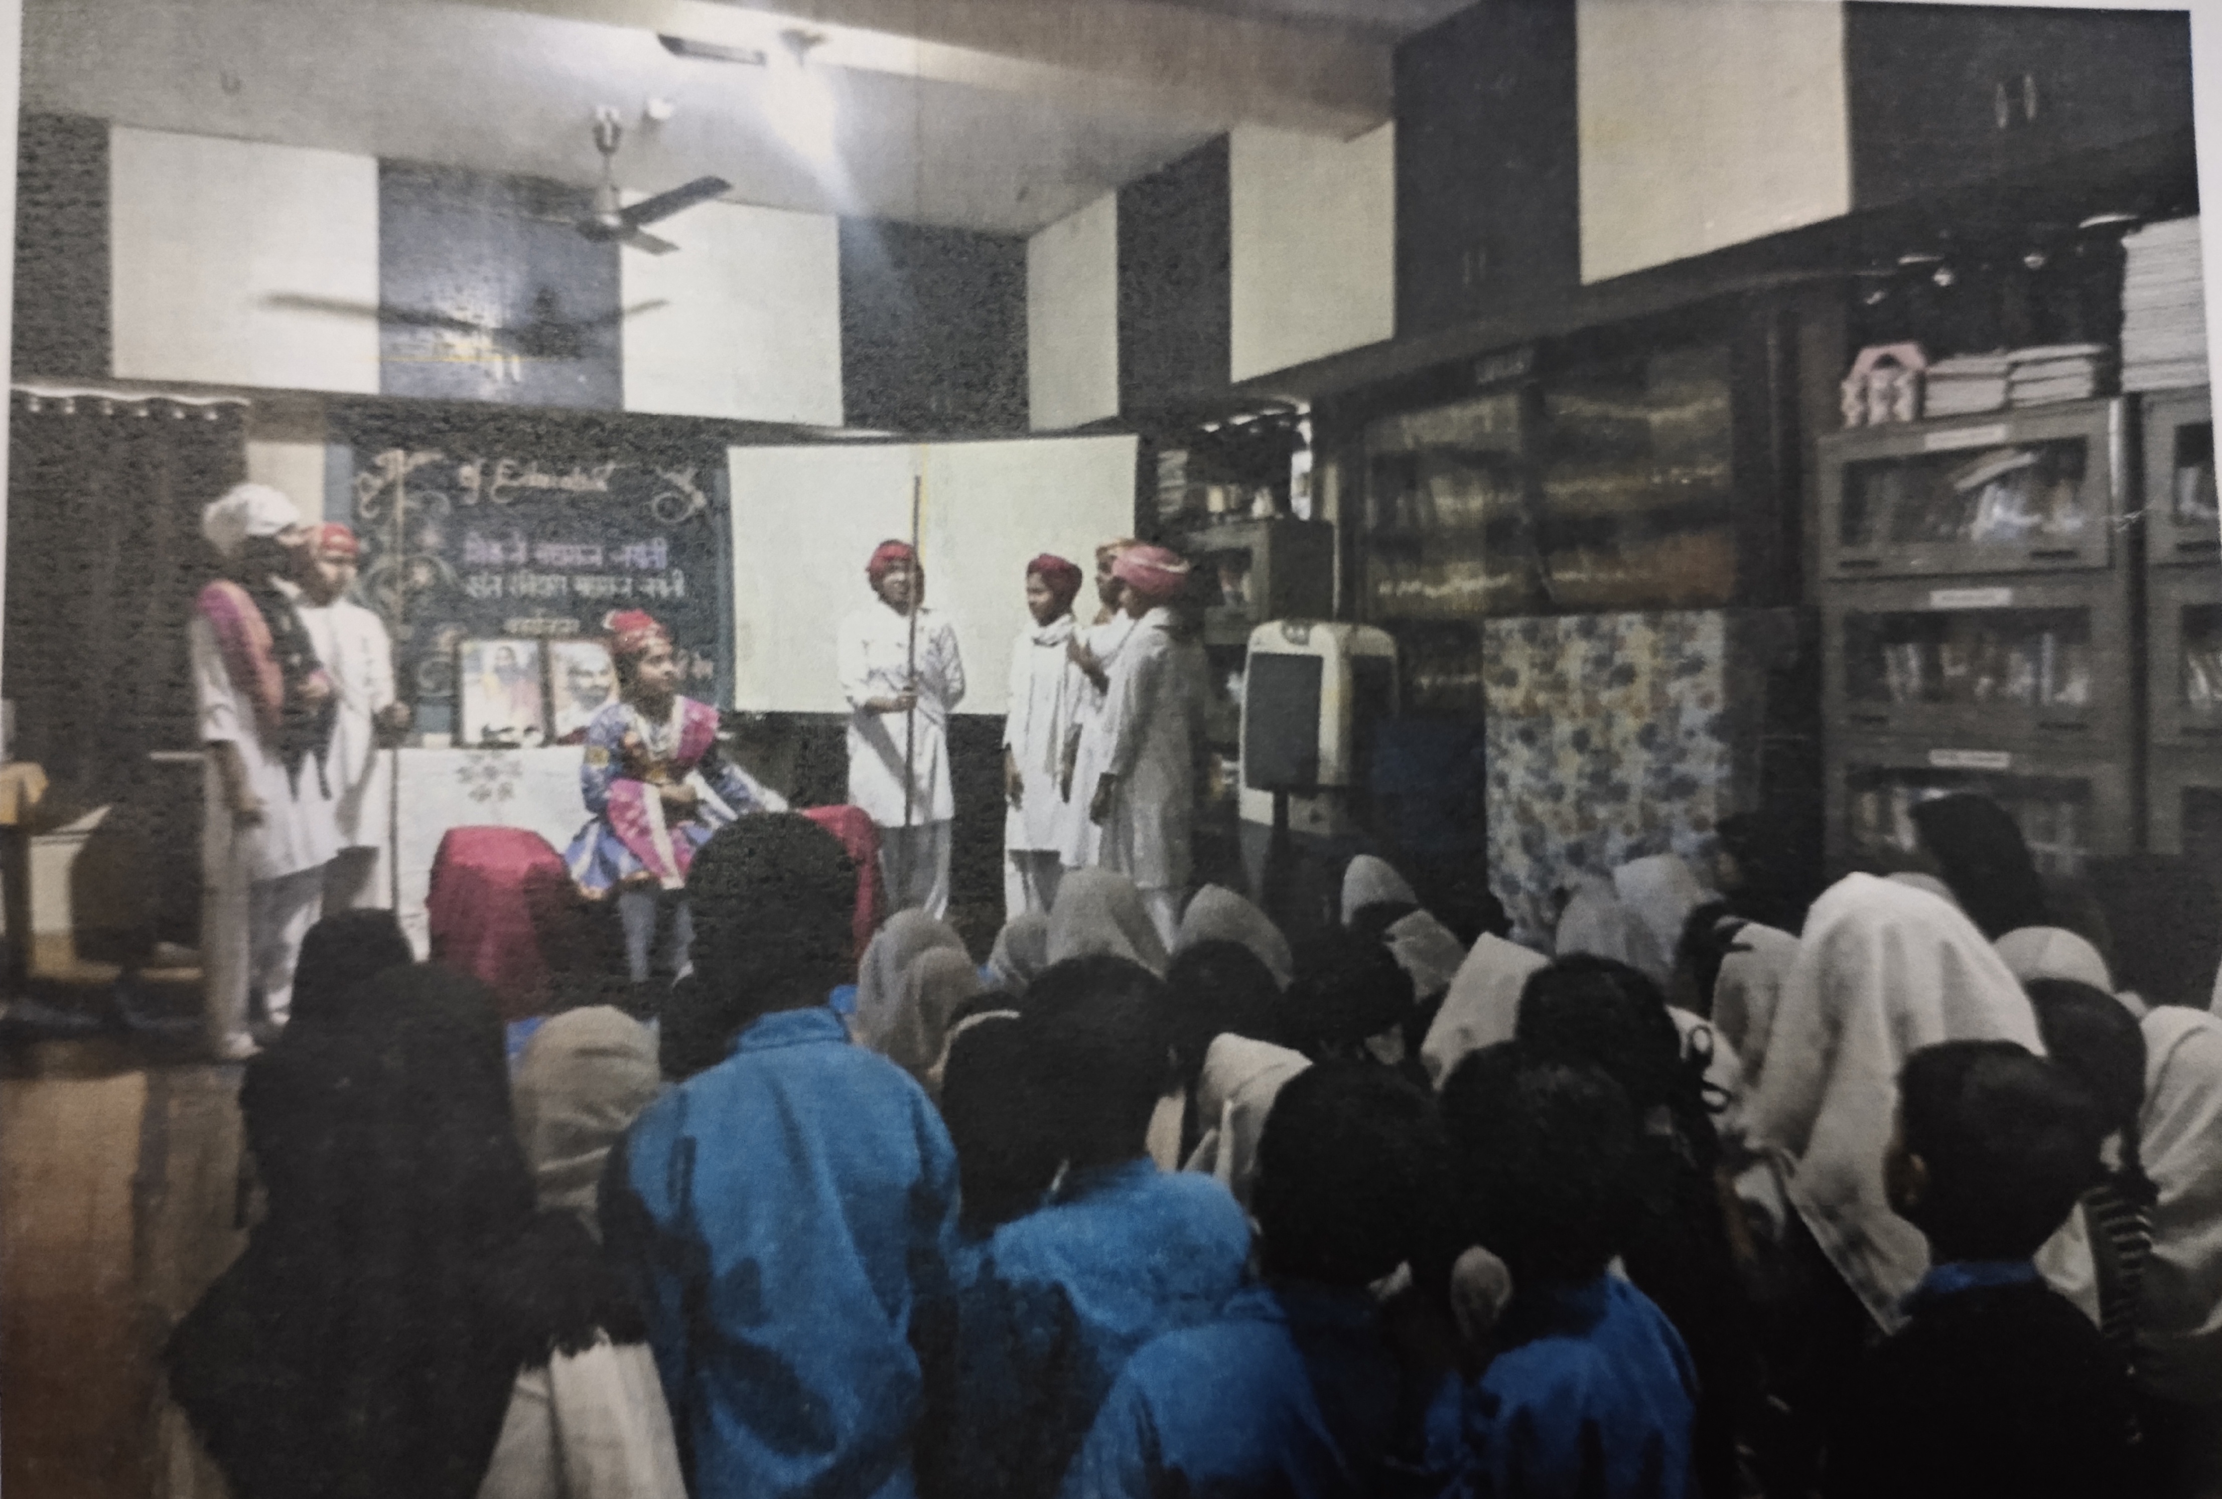
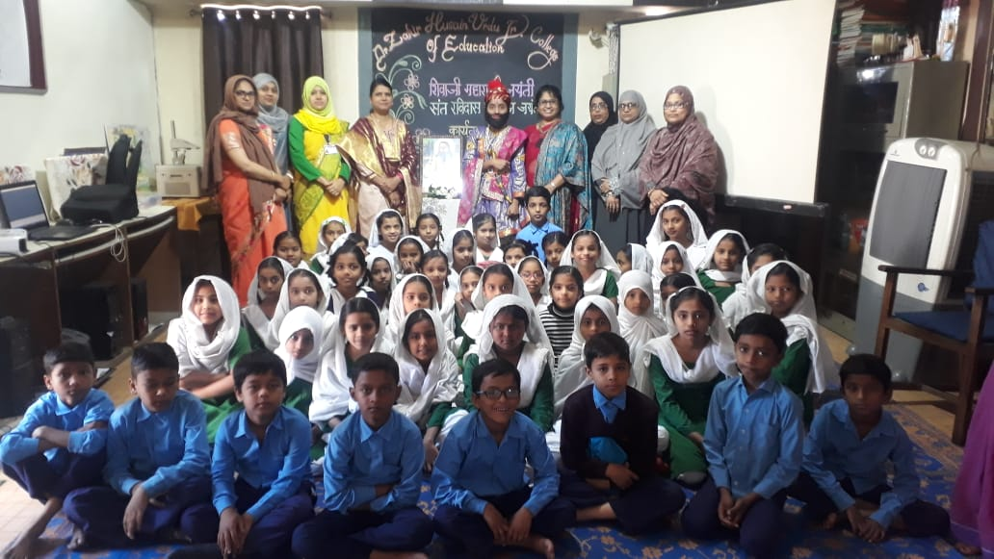

Slide 8
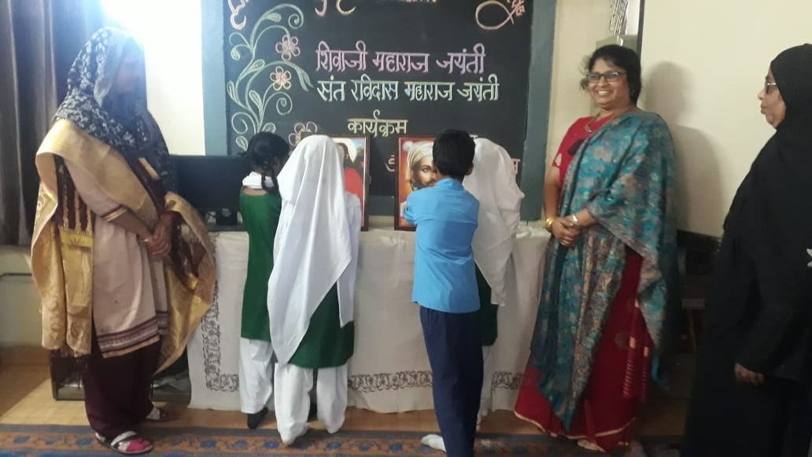
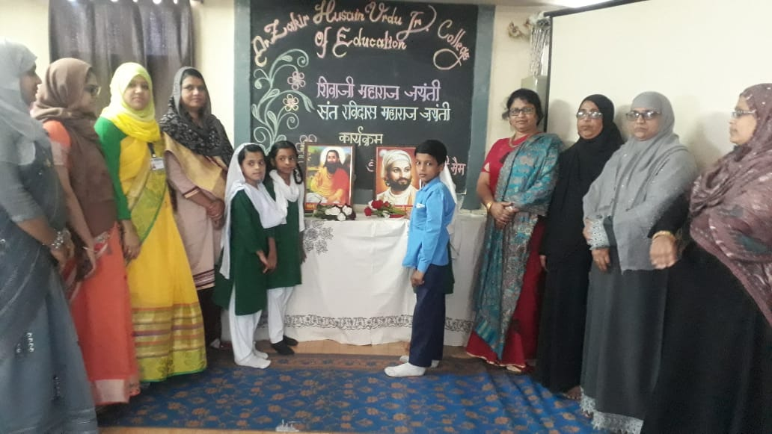

Slide 9
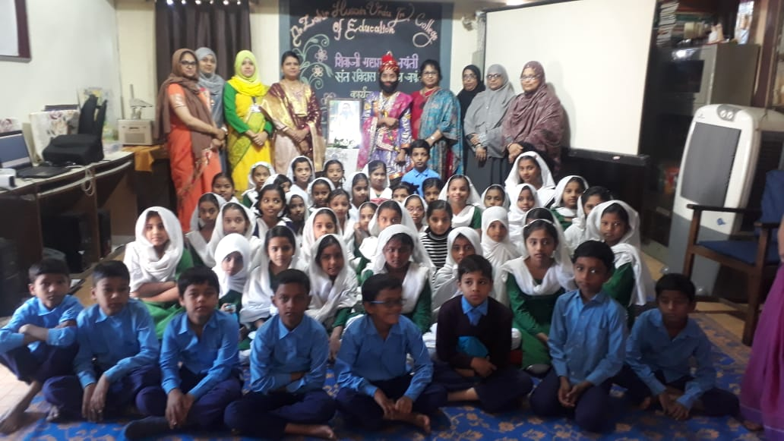

Slide 10
Thank you

